Slide 1
Naive Bayes and Phân loại cảm xúc
The Task of Text Classification
(Phân loại văn bản)

Slide 2
Email có là spam không?

Slide 3
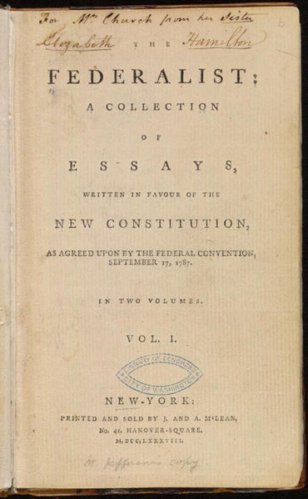
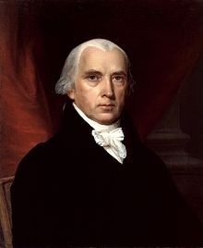
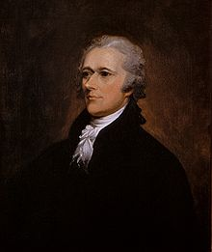
Ai đã viết những bài báo Federalist?
1787-8: anonymous essays try to convince New York to ratify U.S Constitution: Jay, Madison, Hamilton.
Authorship of 12 of the letters in dispute
1963: solved by Mosteller and Wallace using Bayesian methods
James Madison
Alexander Hamilton

Slide 4
Chủ đề của bài báo y học này là gì?
MEDLINE Article
MeSH Subject Category Hierarchy
Antogonists and Inhibitors
Blood Supply
Chemistry
Drug Therapy
Embryology
Epidemiology
…
?

Slide 5
Bình luận về phim là tích cực (pos) hay tiêu cực (neg)?
+
...zany characters and richly applied satire, and some great plot twists
It was pathetic. The worst part about it was the boxing scenes...
...awesome caramel sauce and sweet toasty almonds. I love this place!
...awful pizza and ridiculously overpriced...
−
+
−

Slide 6
Bình luận về phim là tích cực (pos) hay tiêu cực (neg)?
+
...zany characters and richly applied satire, and some great plot twists
It was pathetic. The worst part about it was the boxing scenes...
...awesome caramel sauce and sweet toasty almonds. I love this place!
...awful pizza and ridiculously overpriced...
−
+
−
Notes:
Pathetic = thảm hại
Ridiculously = that nực cười

Slide 7
Tại sao nghiên cứu và phát triển sentiment analysis?
Movie: is this review positive or negative?
Products: what do people think about the new iPhone?
Public sentiment: how is consumer confidence?
Politics: what do people think about this candidate or issue?
Prediction: predict election outcomes or market trends from sentiment

Slide 8
Bài toán phân loại liên quan đến trạng thái tình cảm (affective states)
Emotion: brief organically synchronized … evaluation of a major event
  angry (tức giận), sad (buồn), joyful (vui mừng), fearful (sợ hãi), ashamed (xấu hổ), pround (tự hào), elated (phấn khởi).
Mood: diffuse non-caused low-intensity long-duration change in subjective feeling
  cheerful (vui vẻ), gloomy (ảm đạm), irritable (dễ nổi cáo), listless (bơ phờ), depressed (chán nản), buoyant (sôi động)
Interpersonal stances: affective stance toward another person in a specific interaction
  friendly, flirtatious, distant, cold, warm, supportive, contemptuous
Attitudes: enduring, affectively colored beliefs, dispositions towards objects or persons
  liking, loving, hating, valuing, desiring
Personality traits: stable personality dispositions and typical behavior tendencies
  nervous, anxious, reckless, morose, hostile, jealous

Slide 9
Bài toán phân loại liên quan đến trạng thái tình cảm (affective states)
Emotion: brief organically synchronized … evaluation of a major event
  angry, sad, joyful, fearful, ashamed, proud, elated
Mood: diffuse non-caused low-intensity long-duration change in subjective feeling
  cheerful, gloomy, irritable, listless, depressed, buoyant
Interpersonal stances: affective stance toward another person in a specific interaction
  friendly, flirtatious, distant, cold, warm, supportive, contemptuous
Attitudes: enduring, affectively colored beliefs, dispositions towards objects or persons
  liking (thích), loving (yêu), hating (ghét), valuing, desiring (khát khao)
Personality traits: stable personality dispositions and typical behavior tendencies
  nervous, anxious, reckless, morose, hostile, jealous

Slide 10
Phân loại cảm xúc cơ bản
Sentiment analysis is the detection of attitudes
Simple task we focus on in this chapter
  Is the attitude of this text positive or negative?

Slide 11
Tóm lại: Phân loại văn bản
Phân tích cảm xúc (Sentiment analysis)
Phân loại tin rác (Spam detection)
Nhận dạng quyền tác giả (Authorship identification)
Nhận dạng ngôn ngữ (Language Identification)
Gán các loại chủ đề, chủ đề hoặc thể loại (Assigning subject categories, topics, or genres)
…

Slide 12
Phân loại văn bản: Định nghĩa
Đầu vào:
  Một văn bản d
  Một tập cố định các lớp C = {c₁, c₂,…, c_{J}}
Đầu ra: Một lớp được dự đoán c ∈ C

Slide 13
Các phương pháp phân loại: Dựa trên luật (Hand-coded rules)
Các luật dựa trên việc kết hợp các từ hoặc các đặc trưng khác
  spam: black-list-address OR (“dollars” AND “you have been selected”)
Độ chính xác có thể cao
  Nếu các quy tắc được tinh chỉnh cẩn thận bởi chuyên gia
Nhưng việc xây dựng và duy trì những luật này rất tốn kém

Slide 14
Các phương pháp phân loại:
Máy học giám sát
Đầu vào:
  Một văn bản d
  Một tập cố định các lớp C = {c₁, c₂,…, c_{J}}
  Một tập dữ liệu huấn luyện m các văn bản được gán nhãn sẵn (d₁,c₁),....,(d_{m},c_{m})
Đầu ra:
  Một bộ phân loại đã được huấn luyện γ: d → c

Slide 15
Các phương pháp phân loại:
Máy học giám sát
Các bộ phân loại
  Naïve Bayes
  Logistic regression
  Neural networks
  k-Nearest Neighbors
  …

Slide 16
Phân loại văn bản và Naive Bayes
The Task of Text Classification
(Phân loại văn bản)

Slide 17
Phân loại văn bản và Naive Bayes
Naive Bayes (I)

Slide 18
Trực quan về Naive Bayes
Phương pháp phân loại đơn giản (“naive”) dựa trên luật Bayes
Dựa trên một biểu diễn đơn giản của văn bản
  Bag of words (túi từ)

Slide 19
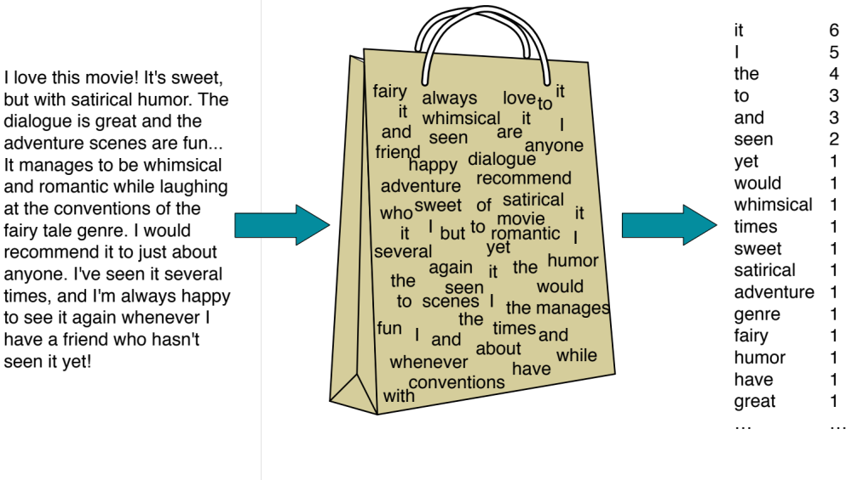
Biểu diễn Bag of Words

Slide 20


Biểu diễn bag of words
seen | 2
sweet | 1
whimsical | 1
recommend | 1
happy | 1
... | ...
γ(
)=c

Slide 21
Phân loại văn bản and Naïve Bayes
Naive Bayes (I)

Slide 22
Phân loại văn bản and Naïve Bayes
Bộ phân lớp Naive Bayes

Slide 23
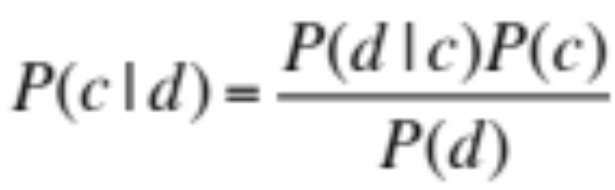
Qui tắc Bayes được áp dụng vào các văn bản và các lớp
Cho một văn bản d và một lớp c

Slide 24
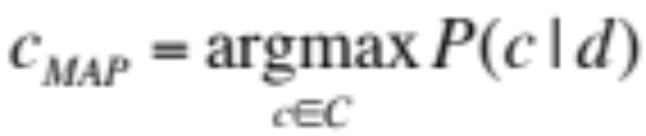
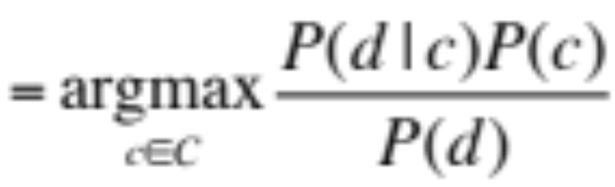
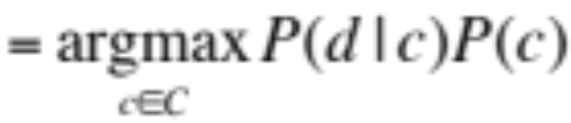
Bộ phân lớp Naive Bayes (I)
MAP is “maximum a posteriori” = most likely class
Luật Bayes
Loại bỏ mẫu số

Slide 25
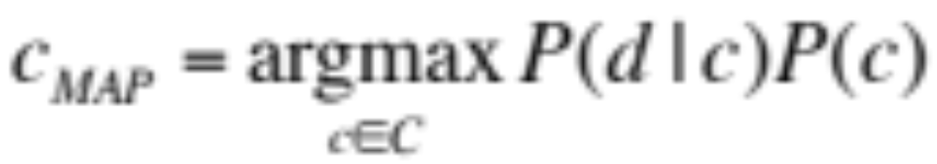
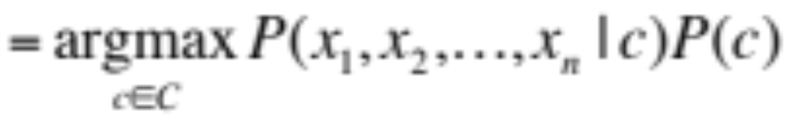
Bộ phân lớp Naive Bayes (II)
"Likelihood"
"Prior"
Văn bản d được biểu diễn như các đặc trưng x1..xn

Slide 26
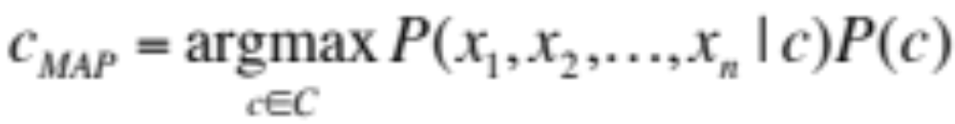
Bộ phân lớp Naïve Bayes (IV)
  O(|X|^{n}•|C|) parameters
How often does this class occur?
  Could only be estimated if a very, very large number of training examples was available.
We can just count the relative frequencies in a corpus

Slide 27
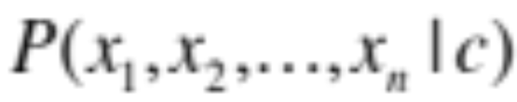
Multinomial Naive Bayes Independence Assumptions
Bag of Words assumption: Assume position doesn’t matter
Conditional Independence: Assume the feature probabilities P(x_{i}|c_{j}) are independent given the class c.

Slide 28
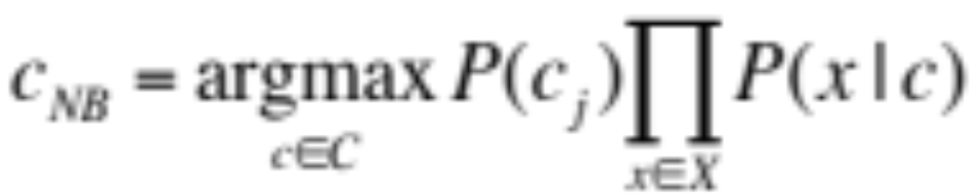
Multinomial Naive Bayes Classifier

Slide 29
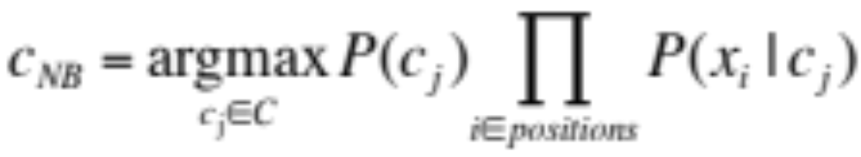
Áp dụng Multinomial Naive Bayes Classifiers vào phân loại văn bản
positions ← all word positions in test document

Slide 30
Problems with multiplying lots of probs
There's a problem with this:
Multiplying lots of probabilities can result in floating-point underflow!
Luckily, log(ab) = log(a) + log(b)
Let's sum logs of probabilities instead of multiplying probabilities!

Slide 31
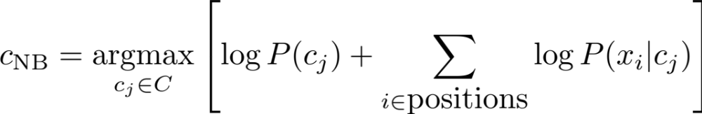
We actually do everything in log space
Instead of this:
This:
This is ok since log doesn't change the ranking of the classes (class with highest prob still has highest log prob)
Model is now just max of sum of weights: a linear function of the inputs
So naive bayes is a linear classifier

Slide 32
Text Classification and Naïve Bayes
Formalizing the Naïve Bayes Classifier

Slide 33
Text Classification and Naïve Bayes
Naive Bayes: Learning

Slide 34
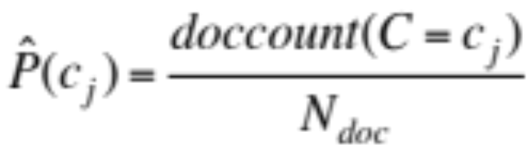
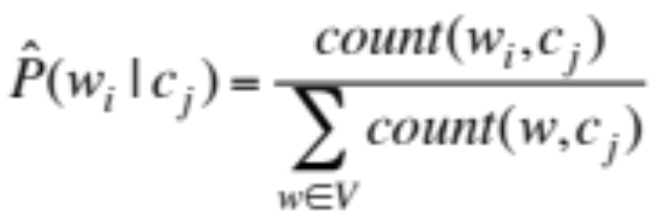
Learning the Multinomial Naive Bayes Model
Sec.13.3
First attempt: maximum likelihood estimates
  simply use the frequencies in the data

Slide 35
Parameter estimation
fraction of times word w_{i} appears
among all words in documents of topic c_{j}

Slide 36
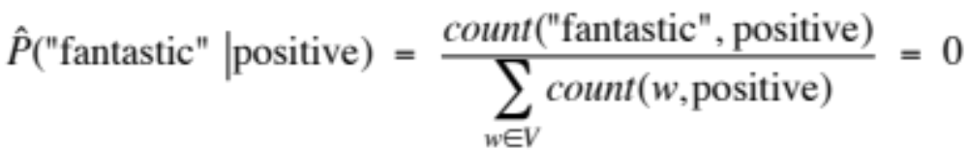
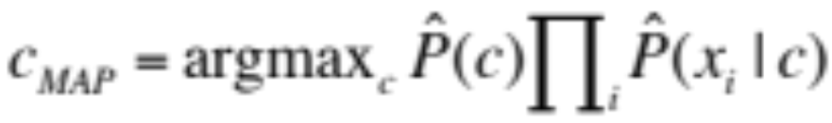
Problem with Maximum Likelihood
Sec.13.3
What if we have seen no training documents with the word fantastic and classified in the topic positive (thumbs-up)?
Zero probabilities cannot be conditioned away, no matter the other evidence!

Slide 37
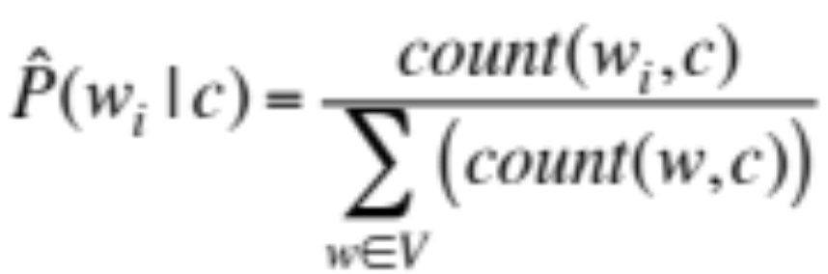
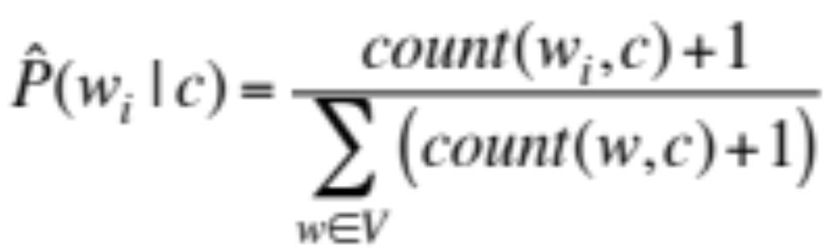
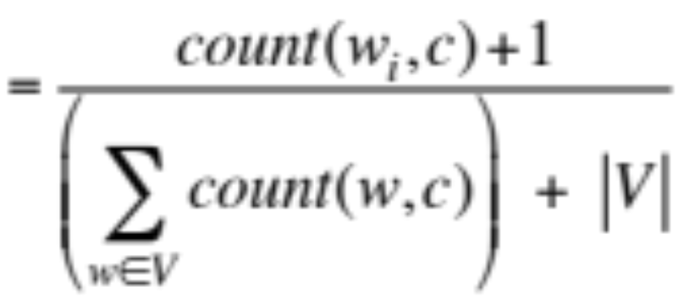
Laplace (add-1) smoothing for Naïve Bayes

Slide 38
Những từ unknown
Những từ unknown:
  Xuất hiện trong tập dữ liệu kiểm tra
  Nhưng không xuất hiện trong tập huấn luyện hoặc tập từ vựng
Bỏ qua (ignore) chúng
  Xoá chúng ra khỏi tập kiểm tra!
  Giả vờ như không có chúng!
  Vì vậy không có xác suất của chúng.

Slide 39
Stop words
Some systems ignore another class of words:
Stop words: very frequent words like the and a.
  Sort the whole vocabulary by frequency in the training, call the top 10 or 50 words the stopword list.
  Now we remove all stop words from the training and test sets as if they were never there.
But in most text classification applications, removing stop words don't help, so it's more common to not use stopword lists and use all the words in naive Bayes.

Slide 40
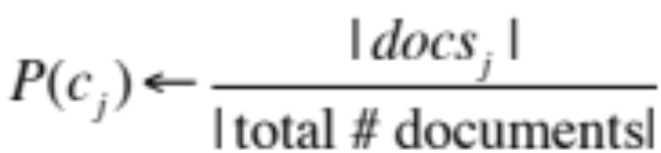
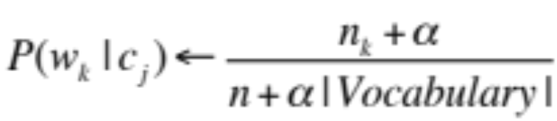
Multinomial Naïve Bayes: Learning
From training corpus, extract Vocabulary
Calculate P(c_{j}) terms
  For each c_{j} in C do
    docs_{j} ← all docs with class =c_{j}
Calculate P(w_{k} | c_{j}) terms
  Text_{j} ← single doc containing all docs_{j}
  For each word w_{k} in Vocabulary
    n_{k} ← # of occurrences of w_{k} in Text_{j}

Slide 41
Text Classification and Naive Bayes
Naive Bayes: Learning

Slide 42
Text Classification and Naive Bayes
Sentiment and Binary Naive Bayes

Slide 43
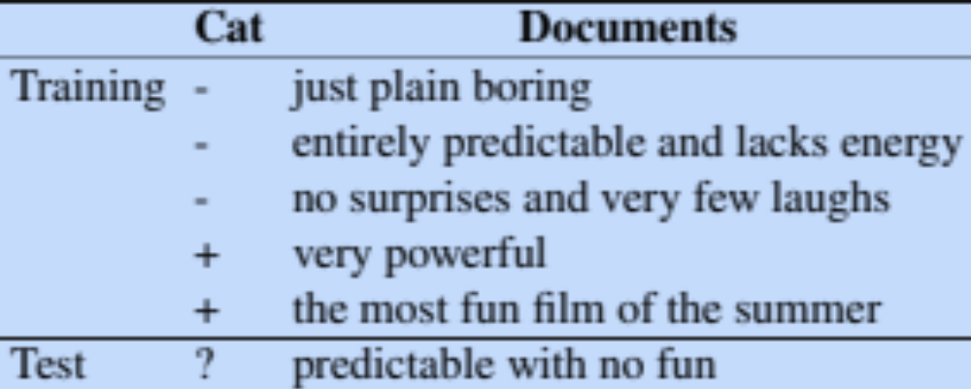
Let's do a worked sentiment example!

Slide 44
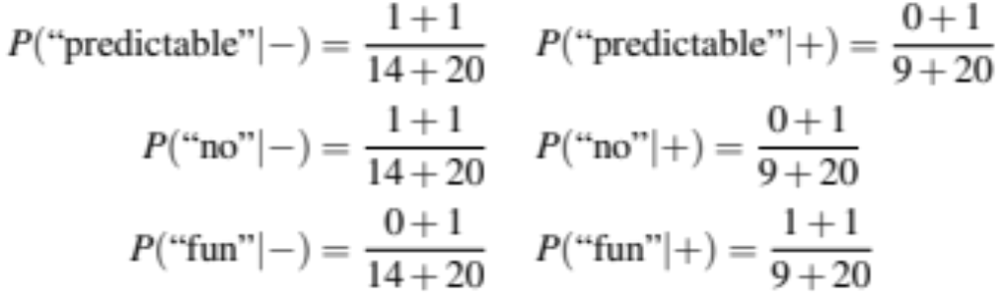
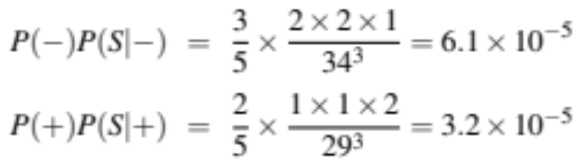
A worked sentiment example
Prior from training:
P(-) = 3/5
P(+) = 2/5
Drop "with"
Likelihoods from training:
Scoring the test set:

Slide 45
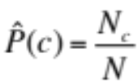
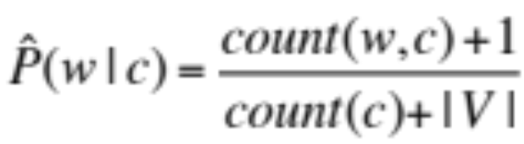
 | Doc | Words | Class
Training | 1 | Chinese Beijing Chinese | c
 | 2 | Chinese Chinese Shanghai | c
 | 3 | Chinese Macao | c
 | 4 | Tokyo Japan Chinese | j
Test | 5 | Chinese Chinese Chinese Tokyo Japan | ?

Slide 46
 | Doc | Words | Class
Training | 1 | Chinese Beijing Chinese | c
 | 2 | Chinese Chinese Shanghai | c
 | 3 | Chinese Macao | c
 | 4 | Tokyo Japan Chinese | j
Test | 5 | Chinese Chinese Chinese Tokyo Japan | ?
Priors:
P(c)=
P(j)=
3
4
1
Choosing a class:
P(c|d5)
P(j|d5)
=> “Chinese Chinese Chinese Tokyo Japan” belongs to “c”.
4
Conditional Probabilities:
P(Chinese|c) =
P(Tokyo|c) =
P(Japan|c) =
P(Chinese|j) =
P(Tokyo|j) =
P(Japan|j) =
  3/4 * (3/7)³ * 1/14 * 1/14
  ≈ 0.0003
(5+1) / (8+6) = 3/7
(0+1) / (8+6) = 1/14
(0+1) / (8+6) = 1/14
  1/4 * (2/9)³ * 2/9 * 2/9
  ≈ 0.0001
(1+1) / (3+6) = 2/9
(1+1) / (3+6) = 2/9
(1+1) / (3+6) = 2/9

Slide 47
Exercise
 | Doc | Sentence | Class
Training | 1 | sản_phẩm A rất tốt. | pos
 | 2 | tôi không thích sản_phẩm A. | neg
 | 3 | màu_sắc của A thật tốt. | pos
 | 4 | sản_phẩm A thật kinh_khủng. | neg
Test | 5 | sản_phẩm A khá tốt. | ?
 | 6 | màu_sắc quá kinh_khủng. | ?

Slide 48
Optimizing for sentiment analysis
For tasks like sentiment, word occurrence is more important than word frequency.
    The occurrence of the word fantastic tells us a lot
    The fact that it occurs 5 times may not tell us much more.
Binary multinominal naive bayes, or binary NB
  Clip our word counts at 1
  Note: this is different than Bernoulli naive bayes; see the textbook at the end of the chapter.

Slide 49
Binary Multinomial Naïve Bayes: Learning
From training corpus, extract Vocabulary
Calculate P(c_{j}) terms
  For each c_{j} in C do
    docs_{j} ← all docs with class =c_{j}
Calculate P(w_{k} | c_{j}) terms
  Text_{j} ← single doc containing all docs_{j}
  For each word w_{k} in Vocabulary
    n_{k} ← # of occurrences of w_{k} in Text_{j}
  Remove duplicates in each doc:
    For each word type w in doc_{j}
      Retain only a single instance of w

Slide 50
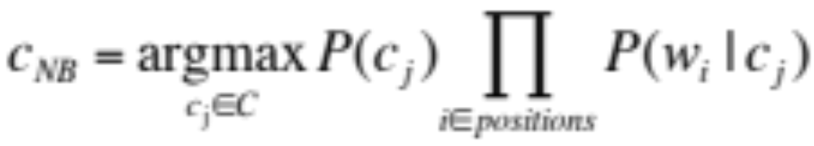
Binary Multinomial Naive Bayes on a test document d
First remove all duplicate words from d
Then compute NB using the same equation:

Slide 51
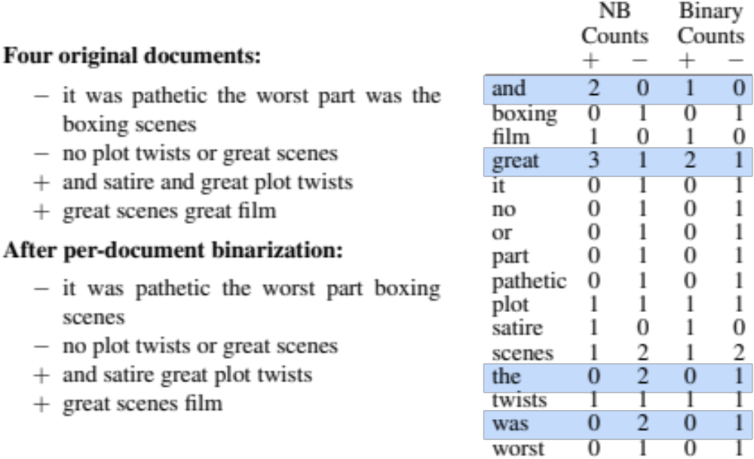
Binary multinominal naive Bayes
Counts can still be 2! Binarization is within-doc!

Slide 52
Text Classification and Naive Bayes
Sentiment and Binary Naive Bayes

Slide 53
Text Classification and Naive Bayes
More on Sentiment Classification

Slide 54
Sentiment Classification: Dealing with Negation
I really like this movie
I really don't like this movie
Negation changes the meaning of "like" to negative.
Negation can also change negative to positive-ish
  Don't dismiss this film
  Doesn't let us get bored

Slide 55
Sentiment Classification: Dealing with Negation
Das, Sanjiv and Mike Chen. 2001. Yahoo! for Amazon: Extracting market sentiment from stock message boards. In Proceedings of the Asia Pacific Finance Association Annual Conference (APFA).
Bo Pang, Lillian Lee, and Shivakumar Vaithyanathan. 2002. Thumbs up? Sentiment Classification using Machine Learning Techniques. EMNLP-2002, 79—86.
Simple baseline method:
Add NOT_ to every word between negation and following punctuation:
didn’t like this movie , but I
didn’t NOT_like NOT_this NOT_movie but I

Slide 56
Sentiment Classification: Lexicons
Sometimes we don't have enough labeled training data
In that case, we can make use of pre-built word lists
Called lexicons
There are various publically available lexicons

Slide 57
MPQA Subjectivity Cues Lexicon
Theresa Wilson, Janyce Wiebe, and Paul Hoffmann (2005). Recognizing Contextual Polarity in
Phrase-Level Sentiment Analysis. Proc. of HLT-EMNLP-2005.
Riloff and Wiebe (2003). Learning extraction patterns for subjective expressions. EMNLP-2003.
Home page: http://www.cs.pitt.edu/mpqa/subj_lexicon.html
6885 words from 8221 lemmas, annotated for intensity (strong/weak)
  2718 positive
  4912 negative
+ : admirable, beautiful, confident, dazzling, ecstatic, favor, glee, great
− : awful, bad, bias, catastrophe, cheat, deny, envious, foul, harsh, hate

Slide 58
The General Inquirer
Philip J. Stone, Dexter C Dunphy, Marshall S. Smith, Daniel M. Ogilvie. 1966. The General Inquirer: A Computer Approach to Content Analysis. MIT Press
  Home page: http://www.wjh.harvard.edu/~inquirer
  List of Categories: http://www.wjh.harvard.edu/~inquirer/homecat.htm
  Spreadsheet: http://www.wjh.harvard.edu/~inquirer/inquirerbasic.xls
Categories:
  Positiv (1915 words) and Negativ (2291 words)
  Strong vs Weak, Active vs Passive, Overstated versus Understated
  Pleasure, Pain, Virtue, Vice, Motivation, Cognitive Orientation, etc
Free for Research Use

Slide 59
Bing Liu Opinion Lexicon
Minqing Hu and Bing Liu. Mining and Summarizing Customer Reviews. ACM SIGKDD-2004.
Bing Liu's Page on Opinion Mining
http://www.cs.uic.edu/~liub/FBS/opinion-lexicon-English.rar
6786 words
  2006 positive
  4783 negative

Slide 60
Using Lexicons in Sentiment Classification
Add a feature that gets a count whenever a word from the lexicon occurs
  E.g., a feature called "this word occurs in the positive lexicon" or "this word occurs in the negative lexicon"
Now all positive words (good, great, beautiful, wonderful) or negative words count for that feature.
Using 1-2 features isn't as good as using all the words.
  But when training data is sparse or not representative of the test set, dense lexicon features can help

Slide 61
Naive Bayes in Other tasks: Spam Filtering
SpamAssassin Features:
  Mentions millions of (dollar) ((dollar) NN,NNN,NNN.NN)
  From: starts with many numbers
  Subject is all capitals
  HTML has a low ratio of text to image area
  "One hundred percent guaranteed"
  Claims you can be removed from the list
  http://spamassassin.apache.org/tests_3_3_x.html

Slide 62
Naïve Bayes in Language ID
Determining what language a piece of text is written in.
Features based on character n-grams do very well
Important to train on lots of varieties of each language (world English, etc)

Slide 63
Summary: Naive Bayes is Not So Naive
Very Fast, low storage requirements
Work well with very small amounts of training data
Very good in domains with many equally important features
  Decision Trees suffer from fragmentation in such cases – especially if little data
Optimal if the independence assumptions hold: If assumed independence is correct, then it is the Bayes Optimal Classifier for problem
A good dependable baseline for text classification
  But we will see other classifiers that give better accuracy
Slide from Chris Manning

Slide 64
Text Classification and Naive Bayes
More on Sentiment Classification

Slide 65
Text Classification and Naïve Bayes
Naïve Bayes: Relationship to Language Modeling

Slide 66
Generative Model for Multinomial Naïve Bayes
c=+
X₁=I
X₂=love
X₃=this
X₄=fun
X₅=film

Slide 67
Naïve Bayes and Language Modeling
Naïve bayes classifiers can use any sort of feature
  URL, email address, dictionaries, network features
But if, as in the previous slides
  We use only word features
  we use all of the words in the text (not a subset)
Then
  Naive bayes has an important similarity to language modeling.

Slide 68
Each class = a unigram language model
Sec.13.2.1
Assigning each word: P(word | c)
Assigning each sentence: P(s|c)=Π P(word|c)
Class pos
0.1 I
0.1 love
0.01 this
0.05 fun
0.1 film
…
I
love
this
fun
film
0.1
0.1
.05
0.01
0.1
P(s | pos) = 0.0000005

Slide 69
Naïve Bayes as a Language Model
Sec.13.2.1
Which class assigns the higher probability to s?
Model pos
Model neg
0.2 I
0.001 love
0.01 this
0.005 fun
0.1 film
0.1 I
0.1 love
0.01 this
0.05 fun
0.1 film
I
love
this
fun
film
0.1
0.1
0.01
0.05
0.1
0.2
0.001
0.01
0.005
0.1
P(s|pos) > P(s|neg)

Slide 70
Text Classification and Naïve Bayes
Naïve Bayes: Relationship to Language Modeling

Slide 71
Phân loại văn bản và Naïve Bayes
Các độ đo đánh giá: Precision, Recall, và F

Slide 72
Đánh giá (Evaluation)
Xem xét trường hợp phân lớp văn bản nhị phân
Tưởng tượng bạn là giám đốc điều hành công ty Delicious Pie Company
Bạn muốn biết mọi người đang nói gì về bánh của bạn
Vì vậy bạn sẽ xây dung một ứng dụng "Delicious Pie" tweet detector
  Positive class: tweets about Delicious Pie Co
  Negative class: all other tweets

Slide 73
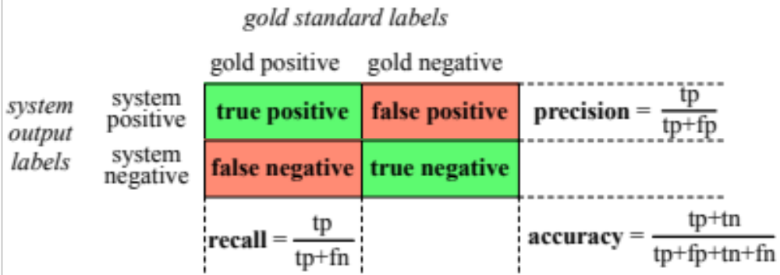
Ma trận nhầm lẫn 2x2

Slide 74
Evaluation: Accuracy
Why don't we use accuracy as our metric?
Imagine we saw 1 million tweets
  100 of them talked about Delicious Pie Co.
  999,900 talked about something else
We could build a dumb classifier that just labels every tweet "not about pie"
  It would get 99.99% accuracy!!! Wow!!!!
  But useless! Doesn't return the comments we are looking for!
  That's why we use precision and recall instead

Slide 75
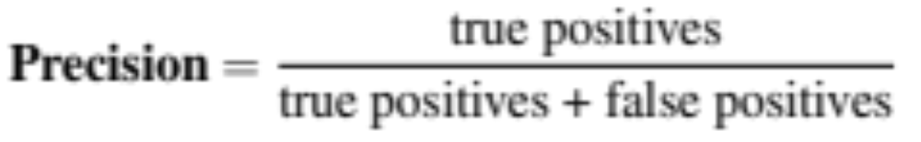
Evaluation: Precision
% of items the system detected (i.e., items the system labeled as positive) that are in fact positive (according to the human gold labels)

Slide 76
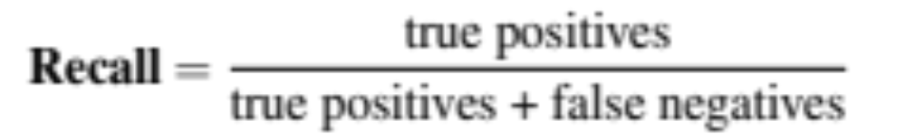
Evaluation: Recall
% of items actually present in the input that were correctly identified by the system.

Slide 77
Why Precision and recall
Our dumb pie-classifier
  Just label nothing as "about pie"
Accuracy=99.99%
  but
Recall = 0
  (it doesn't get any of the 100 Pie tweets)
Precision and recall, unlike accuracy, emphasize true positives:
  finding the things that we are supposed to be looking for.

Slide 78
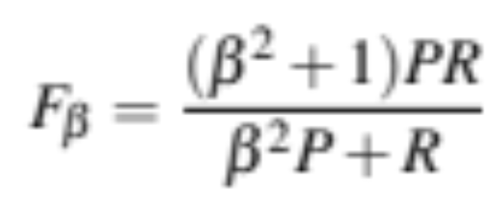
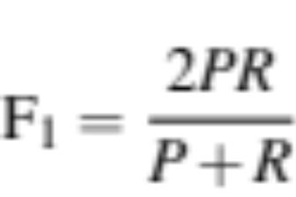
A combined measure: F
F measure: a single number that combines P and R:
We almost always use balanced F₁ (i.e., β = 1)

Slide 79
Development Test Sets ("Devsets") and Cross-validation
Train on training set, tune on devset, report on testset
  This avoids overfitting (‘tuning to the test set’)
  More conservative estimate of performance
  But paradox: want as much data as possible for training, and ad much for dev; how to split?
Training set
Development Test Set
Test Set

Slide 80
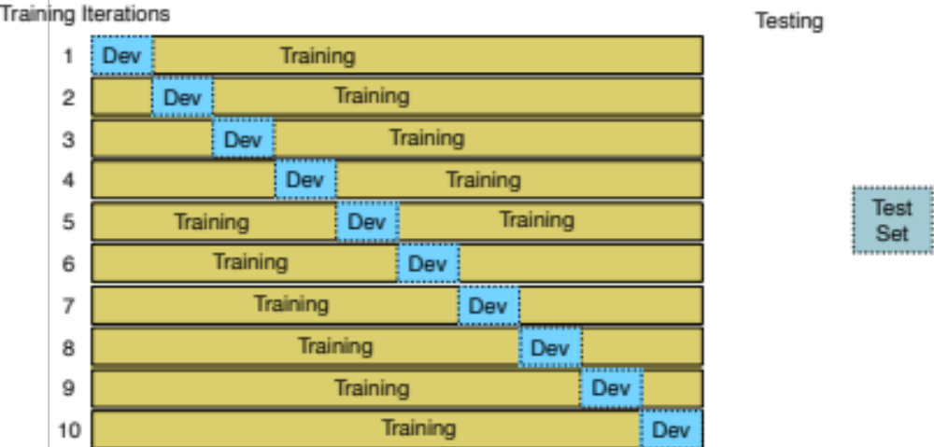
Cross-validation: multiple splits
Pool results over splits, Compute pooled dev performance

Slide 81
Text Classification and Naive Bayes
Precision, Recall, and F measure

Slide 82
Text Classification and Naive Bayes
Evaluation with more than two classes

Slide 83
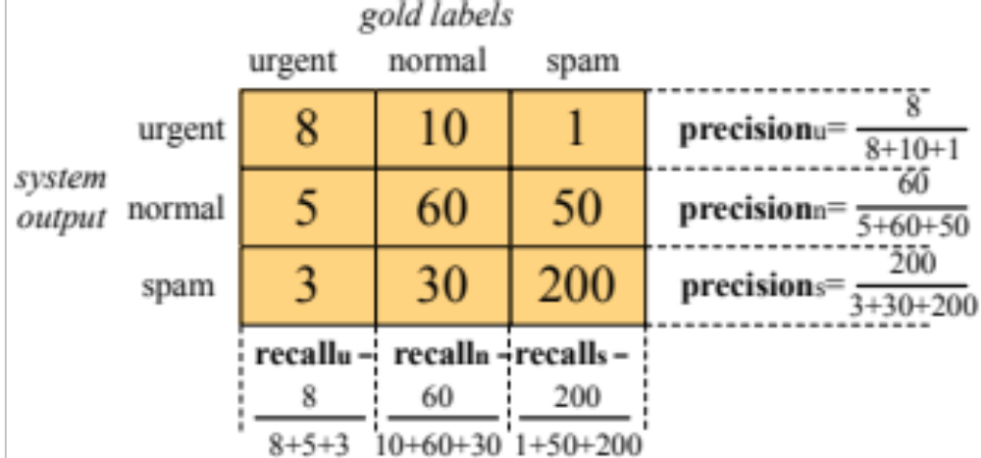
Confusion Matrix for 3-class classification

Slide 84
How to combine P/R from 3 classes to get one metric
Macroaveraging:
  compute the performance for each class, and then average over classes
Microaveraging:
  collect decisions for all classes into one confusion matrix
  compute precision and recall from that table.

Slide 85
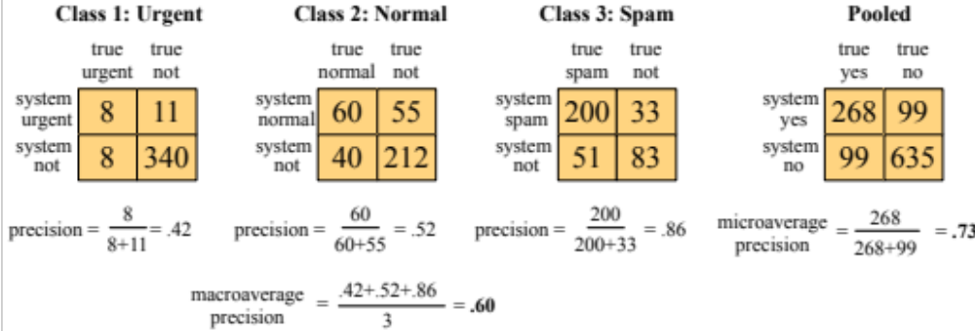
Macroaveraging and Microaveraging

